Slide 1
Hive HA via HA-Proxy
Block Design

Slide 2
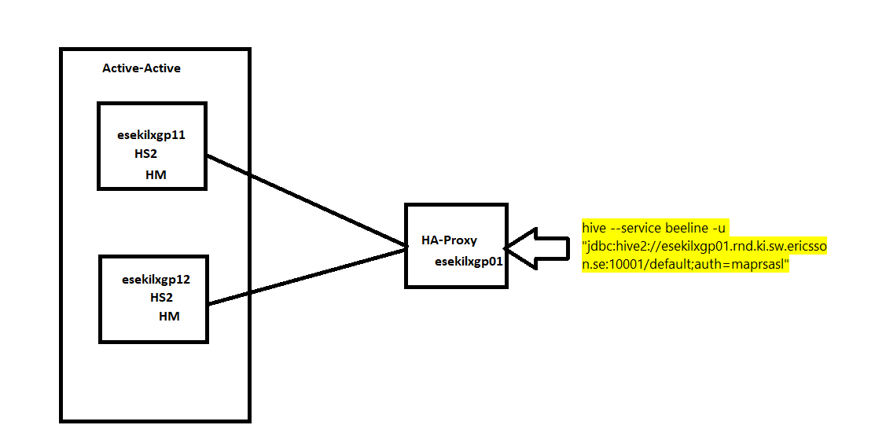
Hive Active-Active via HA Proxy

